Slide 1


SECURE SOFTWARE DEVELOPMENT (SSD)
Diploma in CSF
Academic Year (AY) 22/23 – Semester 3 (April `22)
Week 3
Secure software requirements – Part 1
Last Updated: 8/04/2022

Slide 2
Contents
Mission 3.3: Your First Razor Pages Application Reflections – Individual
Activity 3.1: HTTP vs HTTPS (Confidentiality)
Recap Week 2
Quality Attributes of a Secure Software & Types of Software Security Requirements
Activity 3.2: Cryptographic Hash Functions (Integrity)
Reflections - Individual

Slide 3
Recap Week 2
Research on the following concepts:-
Attacker vs Defender in cybersecurity
What is Confidentiality, Integrity & Availability (CIA)?
What is Authentication, Authorization, Auditing, Accountability?
Explain Non-Repudiation, Data Privacy, Data Anonymization, Personal Data Protection Act.
Read Week 2: Points in the research

Slide 4
Quality Attributes of a Secure Software
Qn: What makes a software secure?
Ans: A software is said to be secured when it is reliable (function as expected), resilient against attacks and readily recoverable when fails.
Reliability
The software functions as it is expected to.
Resiliency
The software does not violate any security policy and is able to withstand the actions of threat agents that are posed intentionally (attacks and exploits) or accidentally (user errors).
Recoverability
The software is able to restore operations to what the business expects by containing, limiting and remediating the damage caused by threats that materialize.

Slide 5
Types of Software Security Requirements
Qn: How to make a software secure?
Ans: For start, gather the necessary software security requirements.
Read Software Security Requirements

Slide 6
Authentication Requirements
The process of validating an entity’s claim is authentication. The entity may be a person, a process or a hardware device.
The common means by which authentication occurs is that the entity provides identity claims and/or credentials which are validated and verified against a trusted source holding those credentials.

Slide 7
The most common forms of authentication
Anonymous
Basic
Digest
Integrated
Client certificates
Forms
Token
Smart cards
Biometrics

Slide 8
Forms Authentication
Predominantly observed in web applications, Forms authentication requires the user to supply a username and password for authentication purposes and these credentials are validated against a directory store which can be the active directory, a database or configuration file.
Since the credentials collected are supplied in clear text form, it is advisable to first cryptographically protect the data being transmitted in addition to implementation transport layer security (TLS) such as SSL or network layer security such as IPSec.
An example of a username and password login box used in Forms authentication.

Slide 9
Authorization Requirements
Role-Based Access Control (RBAC)
In RBAC, individuals (subjects) have access to a resource (object) based on their assigned role.
Permissions to operate on objects such Create, Read, Update or Delete are also defined and determined based on responsibilities and authority (permissions) within the job function.

Slide 10
Authorization Requirements

Slide 11
Availability Requirements
“The software shall ensure high availability of five nines (99.999%) as defined in the SLA.”
“The number of users at any one given point of time who should be able to use the software can be up to 300 users.”
“Software and data should be replicated across data centers to provide load balancing and redundancy.”
“Mission critical functionality in the software should be restored to normal operations within 1 hour of disruption; mission essential functionality in the software should be restored to normal operations within 4 hours of disruption; and mission support functionality in software should be restored to normal operations within 24 hours of disruption.”

Slide 12
Accountability Requirements
Accountability requirements are those that assist in building a historical record of user actions.
Audit trails can help detect when an unauthorized user makes a change or an authorized user makes an unauthorized change, both of which are cases of integrity violations.

Slide 13
Accountability Requirements
The identity of the subject (user or process) performing an action (who)
The action (what)
The object on which the action was performed (where)
The timestamp of the action (when)

Slide 14
Session Management Requirements
“Each user activity will need to be uniquely tracked.”
“The user should not be required to provide user credential once authenticated within the Internet banking application.”
“Sessions must be explicitly abandoned when the user logs off or closes the browser window.”
“Session identifiers used to identify user sessions must not be passed in clear text or be easily guessable.”

Slide 15
Errors & Exception Management Requirements
“All exceptions are to be explicitly handled using try, catch and finally blocks.”
“Error messages that are displayed to the end user will reveal only the needed information without disclosing any internal system error details.”
“Security exception details are to be audited and monitored periodically.”

Slide 16
Software Security Requirements: Explicit vs High-level
Explicit software security requirement such as “The user password will need to be protected against disclosure by masking it while it is input and hashed when it is stored” or “The change in pricing information of a product needs to be tracked and audited, recording the timestamp and the individual who performed that operation” are usually not found within the software requirements specifications document.
What are usually observed are merely high-level non-testable implementation mechanisms and listing of security features such as passwords need to be protected, Secure Sockets Layer (SSL) needs to be in place or a web application firewall needs to be installed in front of our public facing websites.

Slide 17
Activity 3.1: HTTP vs HTTPS (Confidentiality)
Watch Sample - https://www.youtube.com/watch?v=91DwA5aFxLg
Use the Wireshark tool to demonstrate the difference between how HTTP and HTTPS protocols send and receive data on the Internet (Note: Wireshark is available in SSD VM image).
You may visit the below two websites to demo the differences. Sign up using any dummy userID.
http://alumnilifelong.nus.edu.sg/SignUpPage.aspx
https://alumnilifelong.nus.edu.sg/SignUpPage.aspx
Observe the difference in HTTP and HTTPS output of above links. Answer question below inside group “SSD-AY2223-xxx-Pxx-Txx → Week 3” in Teams
Describe which software security requirement does HTTPS protocol satisfies?
Notes:
Tutor to brief students at the end of the activity

Slide 18
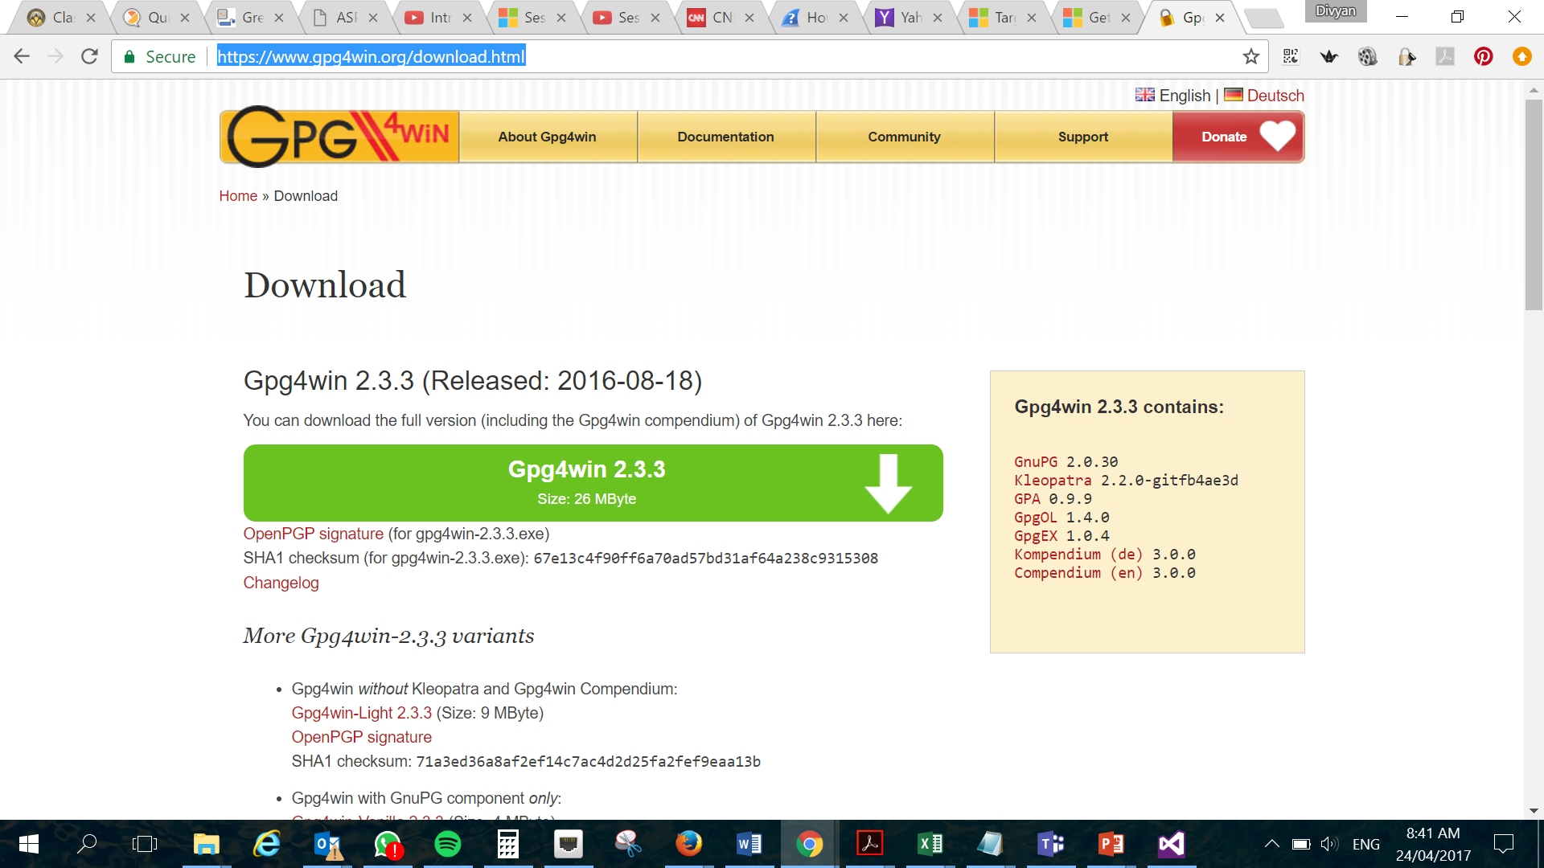
Activity 3.2: Cryptographic Hash Functions (Integrity)
Visit https://www.gpg4win.org/download.html
Inside your “SSD-AY2223-xxx-Pxx-Txx → Week 3”
Create a Wiki/OneNote tab named “Mission 3.2”
Answer the followings:-
Why websites include checksums?
Describe the main characteristics of Cryptographic Hash Functions
How Cryptographic Hash Functions satisfy integrity requirements?
Notes:
Tutor to brief students at the end of the activity

Slide 19
Open-Ended Question
Qn 1: Why is recoverability considered as one of the quality attributes of a secure software?
Go to Teams, create channel Week 3 (if not yet created)
In Week 3 channel, post question above in Teams in conversation, if not posted yet. (SSD module rep, please paste question, if not posted yet)
Answer question above in the Week 3 conversation. Do not create a separate conversation thread for the question.
Discuss/Comment on the answers given in the conversation thread .

Slide 20
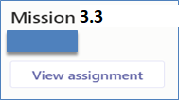
Mission 3.3: Your First Razor Pages Application (Individual)
Please note that Razor Pages mission (Week 1-3) is intentionally released early. The intent is to help you pace learning on Razor Pages.
Visit https://docs.microsoft.com/en-us/aspnet/core/tutorials/razor-pages/
Attempt the following topics:-
Create a Razor Pages web app
Add a model to a Razor Pages app in ASP.NET Core
Scaffolded Razor Pages in ASP.NET Core
Work with a database and ASP.NET Core
Update the generated pages in an ASP.NET Core app
Use .NET Core 3.1 (Long-term support) framework.
Collate detailed screenshots of each of the completed topic in a word document and submit in Brightspace (Week 3).
The screenshots must show the browser’s “Address Bar” to verify the application is running in your laptop.
Submit in General → Assignment (Mission 3.3 Razor Pages Intro)
Deadline: Submit at end of Week 3

